Slide 1
Getting started for multiple regression
Blackboard >> Statistical Inference >> Learning materials >> Week 8
Download MultipleRegression_worksheet.Rmd from Blackboard. Ideally put it in your scripts folder
Open MultipleRegression_worksheet.Rmd in Rstudio. Ideally, set your working directory to the scripts folder.
Make sure you have all the necessary packages installed
Knit to html

Slide 2
Multiple linear regression
Statistical Inference
Week 8

Slide 3
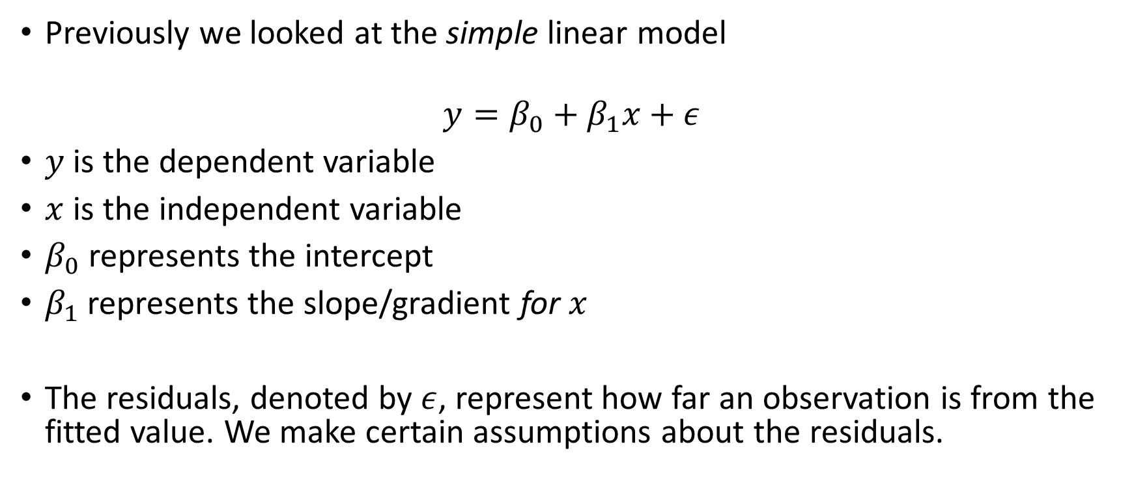
Remember the linear model?
Previously we looked at the simple linear model
$$y=β_{0}+β_{1}x+ε$$
$y$ is the dependent variable
$x$ is the independent variable
$β_{0}$ represents the intercept
$β_{1}$ represents the slope/gradient for $x$
The residuals, denoted by $ε$, represent how far an observation is from the fitted value. We make certain assumptions about the residuals.

Slide 4
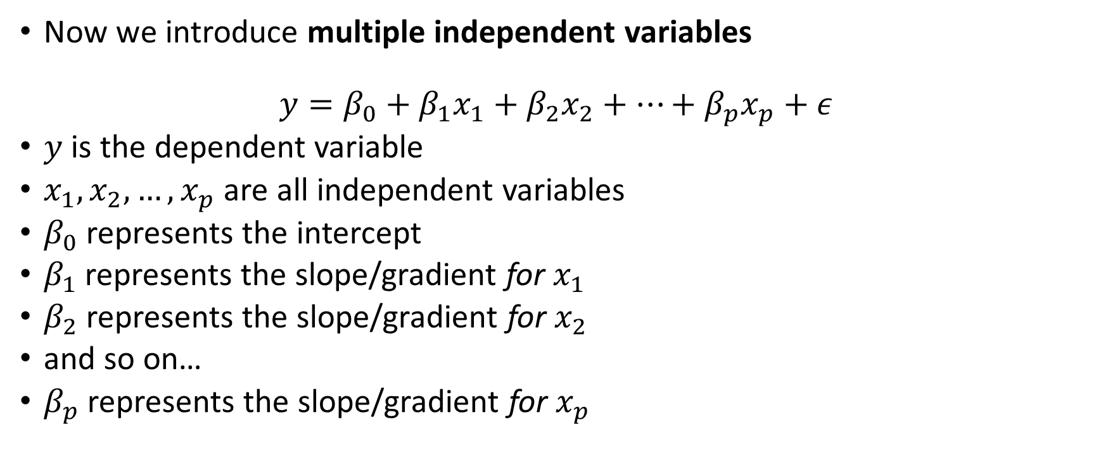
The multiple linear model
Now we introduce multiple independent variables
$$y=β_{0}+β_{1}x_{1}+β_{2}x_{2}+…+β_{p}x_{p}+ε$$
$y$ is the dependent variable
$x_{1},x_{2},…, x_{p}$ are all independent variables
$β_{0}$ represents the intercept
$β_{1}$ represents the slope/gradient for $x_{1}$
$β_{2}$ represents the slope/gradient for $x_{2}$
and so on…
$β_{p}$ represents the slope/gradient for $x_{p}$

Slide 5
Model assumptions
The multiple linear regression model has the same assumptions as the simple linear regression model:
The residuals are
normally distributed,
with a mean of zero,
and a constant variance.
All observations are independent of each other.

Slide 6
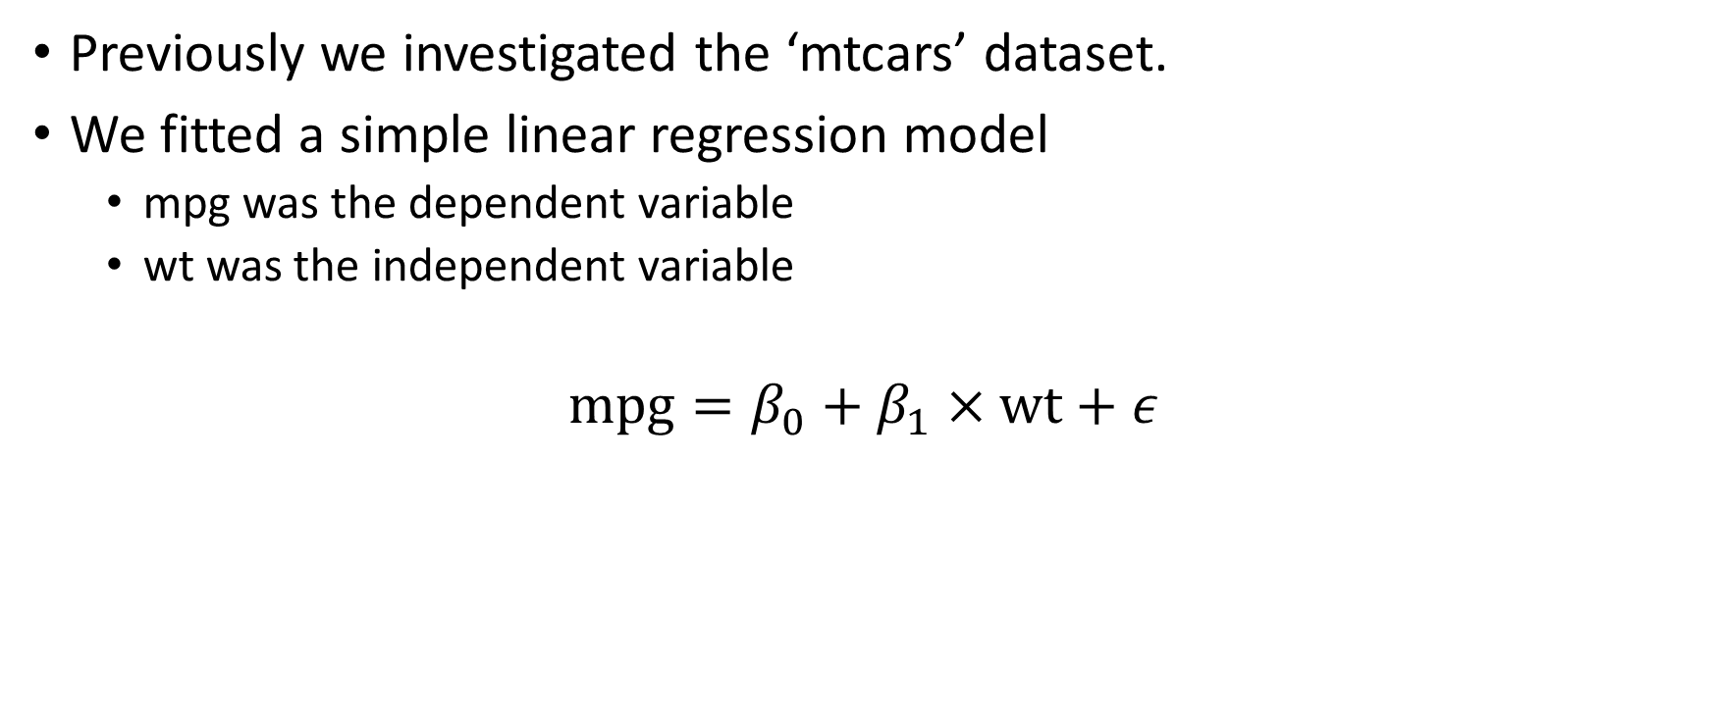
Example
Previously we investigated the ‘mtcars’ dataset.
We fitted a simple linear regression model
mpg was the dependent variable
wt was the independent variable
$$\text{mpg}=β_{0}+β_{1}×\text{wt}+ε$$

Slide 7
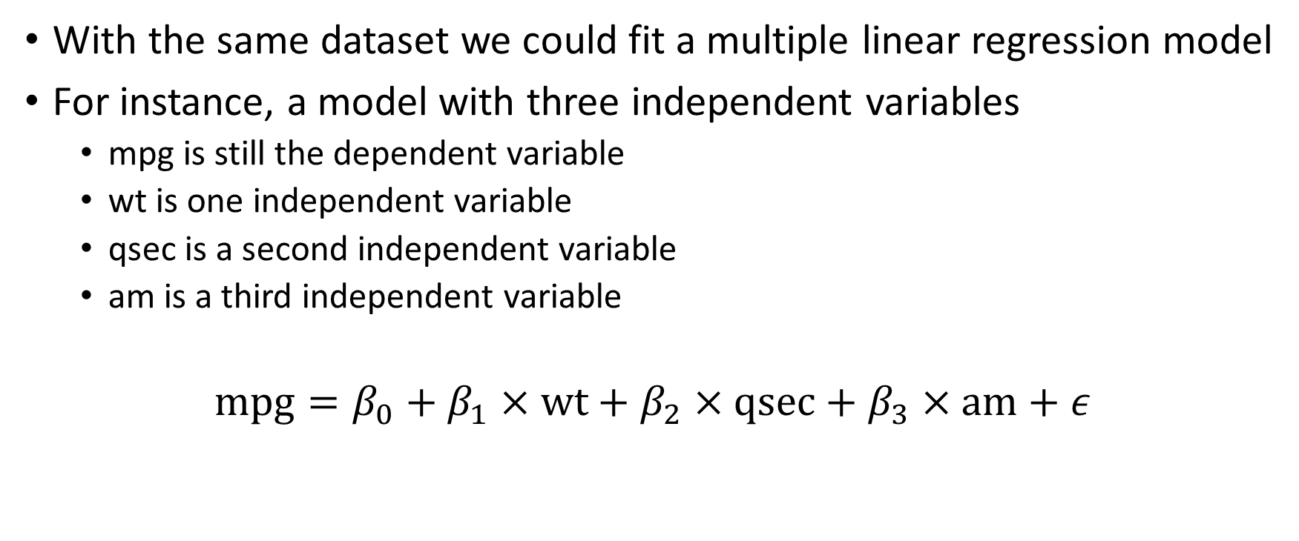
Example
With the same dataset we could fit a multiple linear regression model
For instance, a model with three independent variables
mpg is still the dependent variable
wt is one independent variable
qsec is a second independent variable
am is a third independent variable
$$\text{mpg}=β_{0}+β_{1}×\text{wt}+β_{2}×\text{qsec}+β_{3}×\text{am}+ε$$

Slide 8
Multicollinearity
A certain problem that occurs in multiple linear regression models.
Caused by high correlation(s) between the independent variables.
Leads to various problems, including:
Independent variables appearing not statistically significant when otherwise they might be.
Not able to give precise estimates; model difficult to replicate.
Information overlap: unable to separate variables or their effects.
One solution is to simplify the model:
By dropping correlated independent variables.
Through model selection (such as stepwise AIC).

Slide 9
Interpreting the final model
What is the expected change in mpg as a car’s weight (wt) increases?
qsec is the time to do a quarter-mile from a standing start. What is the difference in mpg for a car that can do a 10 second quarter mile, compared with a car that can only do a 20 second quarter mile?
am = 0 for automatic, am = 1 for manual Which has better mpg, an automatic or a manual car?

